Slide 1
What you Need To KNOW
This benchmark will not be assessed alone, rather, items will include content from one of the other benchmarks and you will be asked to evaluate scenarios using evidence of scientific thinking or problem solving
Test Items may require interpretation of data from graphs, charts and/or tables. You may also be asked to evaluate the merits of scientific explanations produced by others or to assess the reliability of sources of information according to scientific standard
In addition, you may also be asked to compare and/or contrast the structure of various microscopes including compound, dissecting, scanning electron and transmission electron.

Slide 2
Based on this experiment, which of the following should be inferred about cells with semipermeable membranes? A. Substances other than water may also cross the cell membrane. B. Substances other than water may block pores in the cell membrane. C. Water enters the cell when placed in environments of high water concentration. D. Water leaves the cell when placed in environments with a low concentration of solutes
An osmosis investigation was conducted using chicken eggs to represent cells with semipermeable membranes. The mass of each egg was measured to determine how much water diffused into or out of the eggs. The eggs were first soaked in vinegar to dissolve the shell. Each egg was then placed in one of three different solutions for 24 hours. The table below shows the results of the investigation.
Osmosis in Cells
Solution | Average Mass Before Soaking | Average Mass After Soaking | Difference in Average Mass | Percent Change in Average Mass
Vinegar (95% water) | 71.2g | 98.6g | 27.4g | +38.5g
Corn Syrup (5% water) | 98.6g | 64.5g | 34.1g | -34.6g
Distilled Water (100% water) | 64.5g | 105.3g | 40.8g | +63.3g

Slide 3
Based on this experiment, which of the following should be inferred about cells with semipermeable membranes? A. Substances other than water may also cross the cell membrane. B. Substances other than water may block pores in the cell membrane. C. Water enters the cell when placed in environments of high water concentration. D. Water leaves the cell when placed in environments with a low concentration of solutes
An osmosis investigation was conducted using chicken eggs to represent cells with semipermeable membranes. The mass of each egg was measured to determine how much water diffused into or out of the eggs. The eggs were first soaked in vinegar to dissolve the shell. Each egg was then placed in one of three different solutions for 24 hours. The table below shows the results of the investigation.
Osmosis in Cells
Solution | Average Mass Before Soaking | Average Mass After Soaking | Difference in Average Mass | Percent Change in Average Mass
Vinegar (95% water) | 71.2g | 98.6g | 27.4g | +38.5g
Corn Syrup (5% water) | 98.6g | 64.5g | 34.1g | -34.6g
Distilled Water (100% water) | 64.5g | 105.3g | 40.8g | +63.3g

Slide 4
Carmen conducted an experiment to determine if listening to different types of music would affect a person’s pulse. Her hypothesis was that pulse rate would change with different types of music. Each person listened to seven different selections of music for 30 seconds each. Each person’s pulse was taken before the music and then after each 30-second interval of music. The pulses were taken again after the music selections were completed. Based on her experiment, Carmen concluded that a person’s pulse rate changed when the person listened to different types of music.
Which component is missing from Carmen’s experiment?
A. a question
B. a hypothesis
C. a control group
D. a description of the experiment

Slide 5
Carmen conducted an experiment to determine if listening to different types of music would affect a person’s pulse. Her hypothesis was that pulse rate would change with different types of music. Each person listened to seven different selections of music for 30 seconds each. Each person’s pulse was taken before the music and then after each 30-second interval of music. The pulses were taken again after the music selections were completed. Based on her experiment, Carmen concluded that a person’s pulse rate changed when the person listened to different types of music.
Which component is missing from Carmen’s experiment?
A. a question
B. a hypothesis
C. a control group
D. a description of the experiment

Slide 6
The graph shows atmospheric
carbon dioxide levels since the
year 1880.
Which of the following conclusions can be drawn from this graph?
A. Atmospheric carbon dioxide levels are responsible for global temperature change.
B. Atmospheric carbon dioxide levels have been rising at about the same rate for the past century.
C. Atmospheric carbon dioxide levels have remained the same over the past century.
D. Atmospheric carbon dioxide levels have been rising at an increasingly higher rate as the past century has progressed.

Slide 7
The graph shows atmospheric
carbon dioxide levels since the
year 1880.
Which of the following conclusions can be drawn from this graph?
A. Atmospheric carbon dioxide levels are responsible for global temperature change.
B. Atmospheric carbon dioxide levels have been rising at about the same rate for the past century.
C. Atmospheric carbon dioxide levels have remained the same over the past century.
D. Atmospheric carbon dioxide levels have been rising at an increasingly higher rate as the past century has progressed.

Slide 8
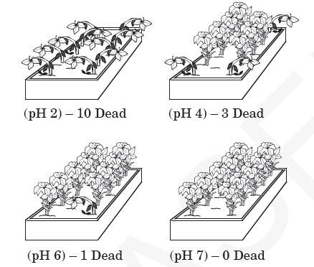
A scientist performs an experiment to see if acids have an effect on the health of a particular type of plant. Three sets of plants were treated with acidic solutions of known pH while the control set was treated with a solution of neutral pH 7.
Which is the best conclusion
for this experiment?
Acid has no effect on the
health of this type of plant.
B. High acidity is helpful to this type of plant.
C. Low acidity is harmful to this type of plant.
D. High acidity is harmful to this type of plant.

Slide 9
A scientist performs an experiment to see if acids have an effect on the health of a particular type of plant. Three sets of plants were treated with acidic solutions of known pH while the control set was treated with a solution of neutral pH 7.
Which is the best conclusion
for this experiment?
Acid has no effect on the
health of this type of plant.
B. High acidity is helpful to this type of plant.
C. Low acidity is harmful to this type of plant.
D. High acidity is harmful to this type of plant.

Slide 10
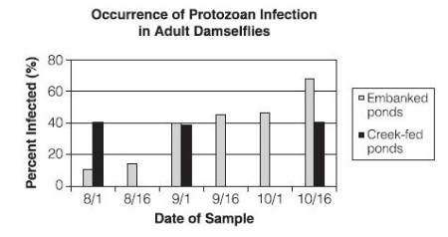
A research group has discovered that damselflies, a type of dragonfly, are being infected by a particular type of aquatic protozoan. Both young and adult damselflies are not directly infected by the protozoan but contract the infection from the prey they eat. The graph shows the percentage of adult damselflies infected by protozoans during the summer and early fall.
Which of the following conclusions
is supported by the graph?
A. Infection in embanked ponds increased during the sampling period.
B. Protozoans were more common in creek-fed ponds than embanked ponds.
C. Protozoans reproduce more quickly in embanked ponds than creek-fed ponds.
D. Infection in creed-fed ponds remained constant throughout the sampling period.

Slide 11
A research group has discovered that damselflies, a type of dragonfly, are being infected by a particular type of aquatic protozoan. Both young and adult damselflies are not directly infected by the protozoan but contract the infection from the prey they eat. The graph shows the percentage of adult damselflies infected by protozoans during the summer and early fall.
Which of the following
conclusions is supported
by the graph?
A. Infection in embanked ponds increased during the sampling period.
B. Protozoans were more common in creek-fed ponds than embanked ponds.
C. Protozoans reproduce more quickly in embanked ponds than creek-fed ponds.
D. Infection in creed-fed ponds remained constant throughout the sampling period.

