Slide 1
Cell Reproduction

Slide 2
Types of Cell Reproduction
Asexual reproduction involves a single cell dividing to make 2 new, identical daughter cells
Mitosis & binary fission are examples of asexual reproduction
Sexual reproduction involves two cells (egg & sperm) joining to make a new cell (zygote) that is NOT identical to the original cells
Meiosis is an example

Slide 3
Cell Division in Prokaryotes

Slide 4
Cell Division in Prokaryotes
Prokaryotes such as bacteria divide into 2 identical cells by the process of binary fission
Single chromosome makes a copy of itself
Cell wall forms between the chromosomes dividing the cell
Parent cell
Chromosome doubles
Cell splits
2 identical daughter cells

Slide 5
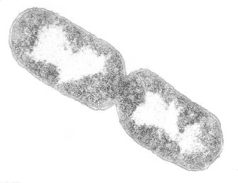
Prokaryotic Cell Undergoing Binary Fission

Slide 6
Animation of Binary Fission

Slide 7
The Cell Cycle

Slide 8
Five Phases of the Cell Cycle
G₁ - primary growth phase
S – synthesis; DNA replicated
G₂ - secondary growth phase
collectively these 3 stages are called interphase
M - mitosis
C - cytokinesis

Slide 9
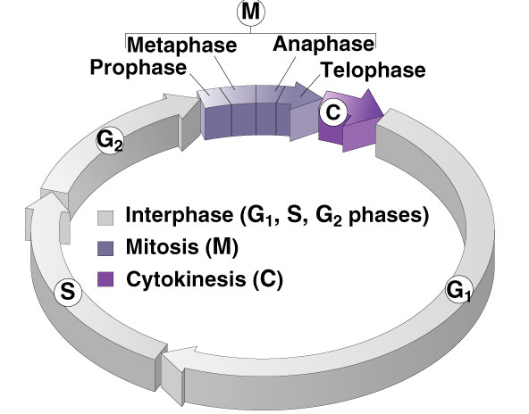
Cell Cycle

Slide 10
Interphase - G₁ Stage
1st growth stage after cell division
Cells mature by making more cytoplasm & organelles
Cell carries on its normal metabolic activities

Slide 11
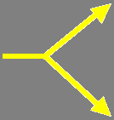
Interphase – S Stage
Synthesis stage
DNA is copied or replicated
Two identical copies of DNA
Original DNA

Slide 12
Interphase – G₂ Stage
2nd Growth Stage
Occurs after DNA has been copied
All cell structures needed for division are made (e.g. centrioles)
Both organelles & proteins are synthesized

Slide 13
What’s Happening in Interphase?
What the cell looks like
Animal Cell
What’s occurring

Slide 14
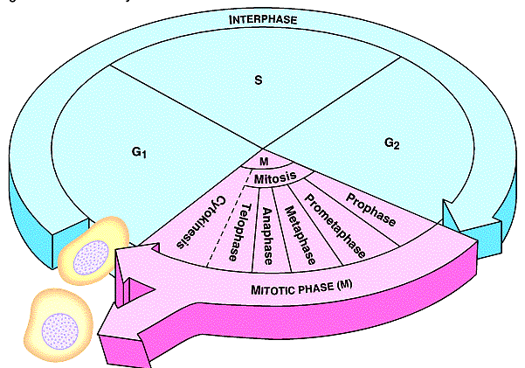
Sketch the Cell Cycle
DNA Copied
Cells prepare for Division
Cells Mature
Daughter Cells
Cell Divides into Identical cells

Slide 15
Mitosis

Slide 16
Mitosis
Division of the nucleus
Also called karyokinesis
Only occurs in eukaryotes
Has four stages
Doesn’t occur in some cells such as brain cells

Slide 17
Four Mitotic Stages
Prophase
Metaphase
Anaphase
Telophase

Slide 18
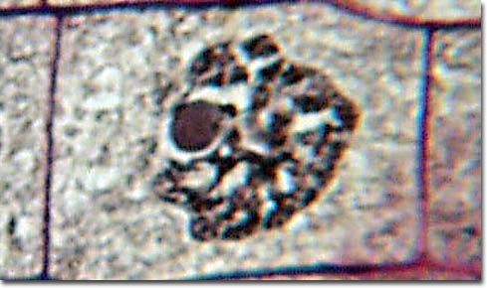
Early Prophase
Chromatin in nucleus condenses to form visible chromosomes
Mitotic spindle forms from fibers in cytoskeleton or centrioles (animal)
Nucleolus
Cytoplasm
Nuclear Membrane
Chromosomes

Slide 19
Late Prophase
Nuclear membrane & nucleolus are broken down
Chromosomes continue condensing & are clearly visible
Spindle fibers called kinetochores attach to the centromere of each chromosome
Spindle finishes forming between the poles of the cell

Slide 20
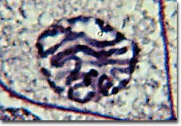
Late Prophase
Chromosomes
Nucleus & Nucleolus have disintegrated

Slide 21
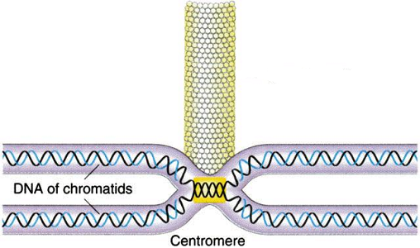
Spindle Fiber attached to Chromosome
Kinetochore Fiber
Chromosome

Slide 22
Review of Prophase
What the cell looks like
What’s happening

Slide 23
Spindle Fibers
The mitotic spindle form from the microtubules in plants and centrioles in animal cells
Polar fibers extend from one pole of the cell to the opposite pole
Kinetochore fibers extend from the pole to the centromere of the chromosome to which they attach
Asters are short fibers radiating from centrioles

Slide 24
Sketch The Spindle

Slide 25
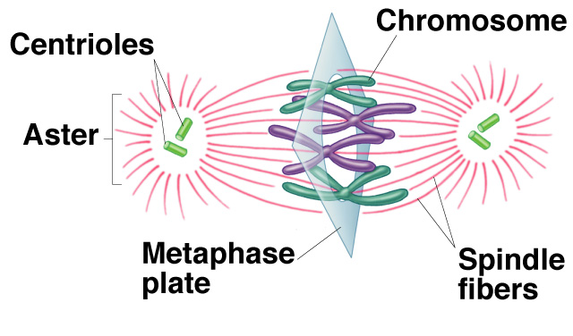
Metaphase
Chromosomes, attached to the kinetochore fibers, move to the center of the cell
Chromosomes are now lined up at the equator
Equator of Cell
Pole of the Cell

Slide 26
Metaphase
Asters at the poles
Spindle Fibers
Chromosomes lined at the Equator

Slide 27
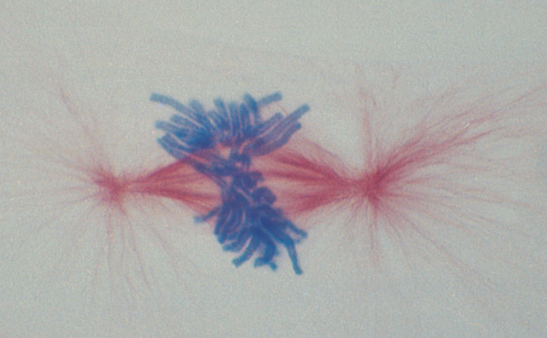
Metaphase
Aster
Chromosomes at Equator

Slide 28
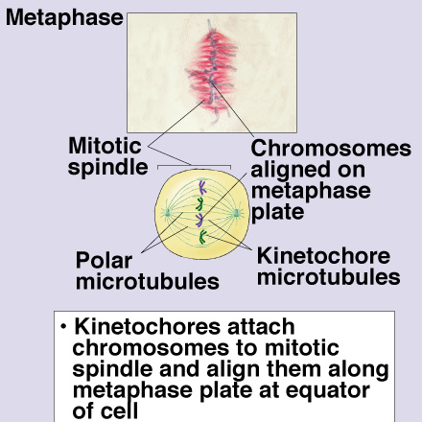
Review of Metaphase
What the cell looks like
What’s occurring

Slide 29
Anaphase
Occurs rapidly
Sister chromatids are pulled apart to opposite poles of the cell by kinetochore fibers

Slide 30
Anaphase
Sister Chromatids being separated

Slide 31
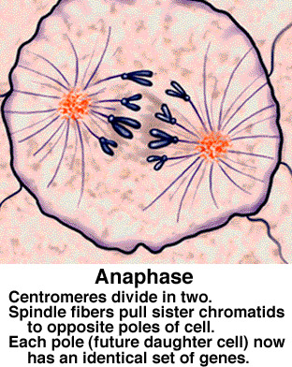
Anaphase Review
What the cell looks like
What’s occurring

Slide 32
Telophase
Sister chromatids at opposite poles
Spindle disassembles
Nuclear envelope forms around each set of sister chromatids
Nucleolus reappears
CYTOKINESIS occurs
Chromosomes reappear as chromatin

Slide 33
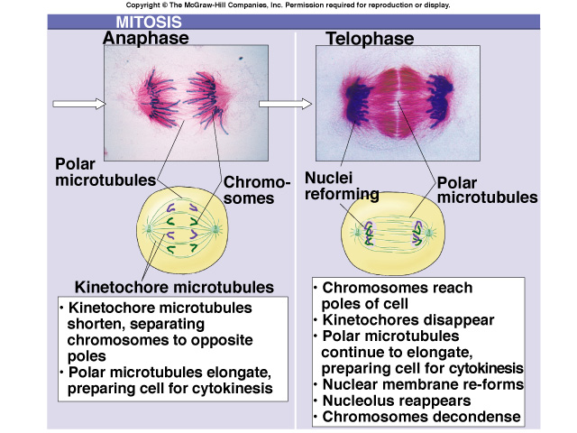
Comparison of Anaphase & Telophase

Slide 34
Cytokinesis
Means division of the cytoplasm
Division of cell into two, identical halves called daughter cells
In plant cells, cell plate forms at the equator to divide cell
In animal cells, cleavage furrow forms to split cell

Slide 35
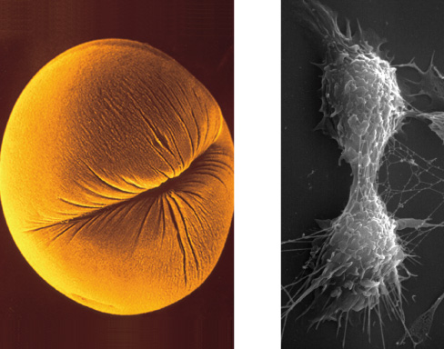
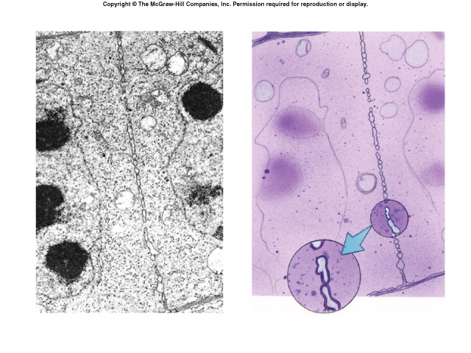
Cytokinesis
Cleavage furrow in animal cell
Cell plate in animal cell

Slide 36
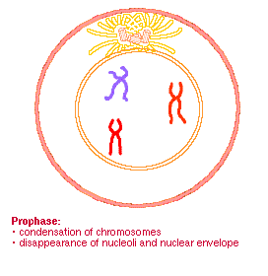
Mitotic Stages

Slide 37
Daughter Cells of Mitosis
Have the same number of chromosomes as each other and as the parent cell from which they were formed
Identical to each other, but smaller than parent cell
Must grow in size to become mature cells (G₁ of Interphase)

Slide 38
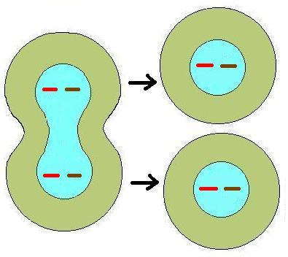
Identical Daughter Cells
What is the 2n or diploid number?
2
Chromosome number the same, but cells smaller than parent cell

Slide 39
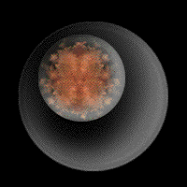
Review of Mitosis

Slide 40
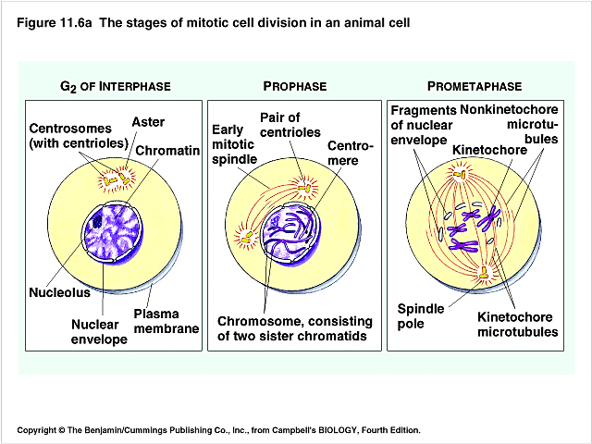
Draw & Learn these Stages

Slide 41
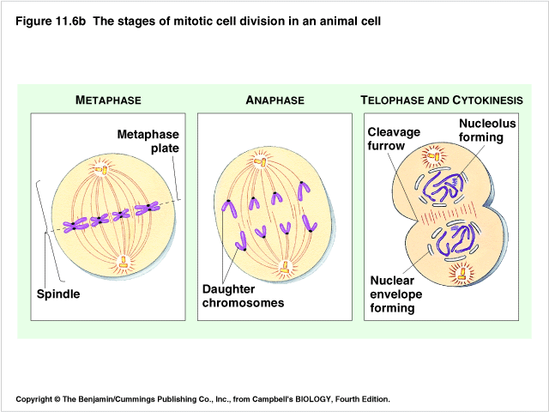
Draw & Learn these Stages

Slide 42
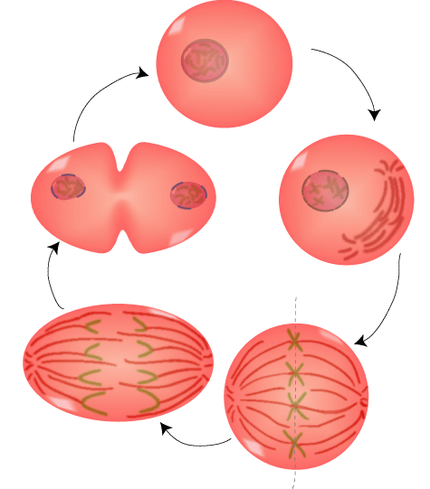
Name the Mitotic Stages:
Interphase
Name this?
Prophase
Telophase
Name this?
Metaphase
Anaphase

Slide 43
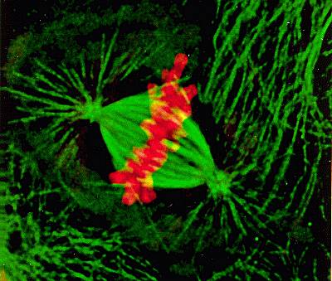
Eukaryotic Cell Division
Used for growth and repair
Produce two new cells identical to the original cell
Cells are diploid (2n)
Chromosomes during Metaphase of mitosis
Anaphase
Cytokinesis
Prophase
Metaphase
Telophase

Slide 44
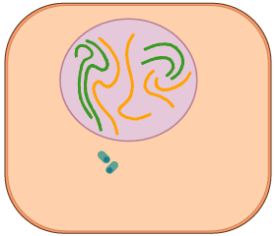
Mitosis Animation
Name each stage as you see it occur?

Slide 45
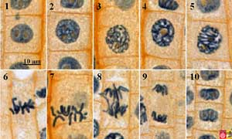
Mitosis in Onion Root Tips
Do you see any stages of mitosis?

Slide 46
Test Yourself over Mitosis

Slide 47
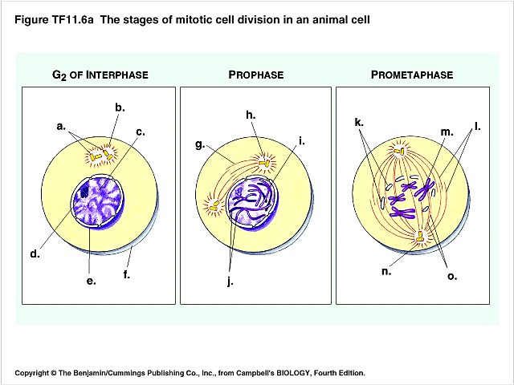
Mitosis Quiz

Slide 48
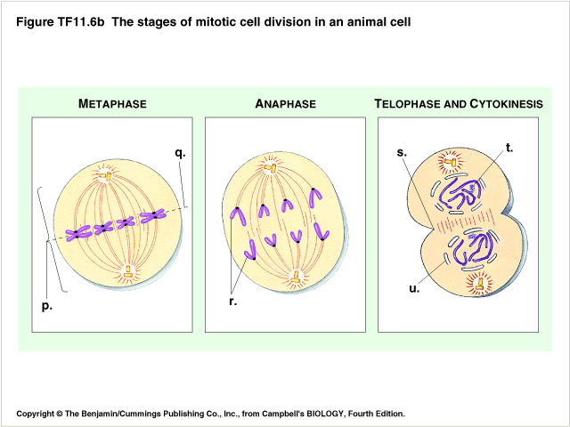
Mitosis Quiz

Slide 49
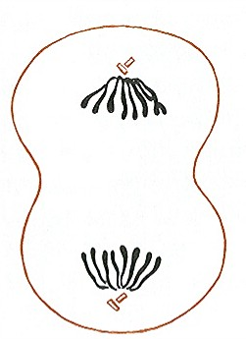
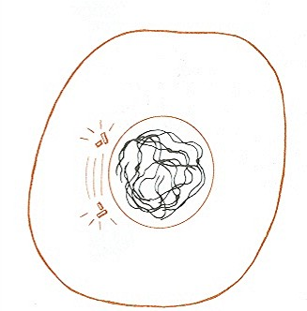
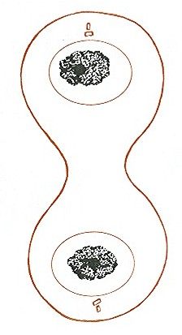
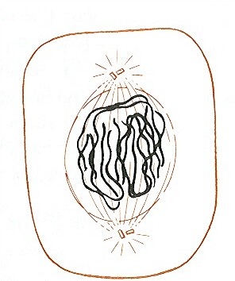
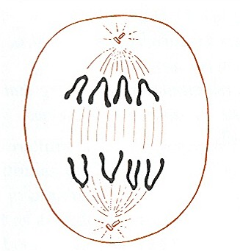
Name the Stages of Mitosis:
Early prophase
Early Anaphase
Metaphase
Interphase
Early Telophase,
Begin cytokinesis
Late Prophase
Late telophase,
Advanced cytokinesis
Mid-Prophase
Late Anaphase

Slide 50
Identify the Stages
?
Early, Middle, & Late Prophase
?
?
?
Metaphase
Anaphase
Late Prophase
?
?
?
Late Anaphase
Telophase
Telophase & Cytokinesis

Slide 51
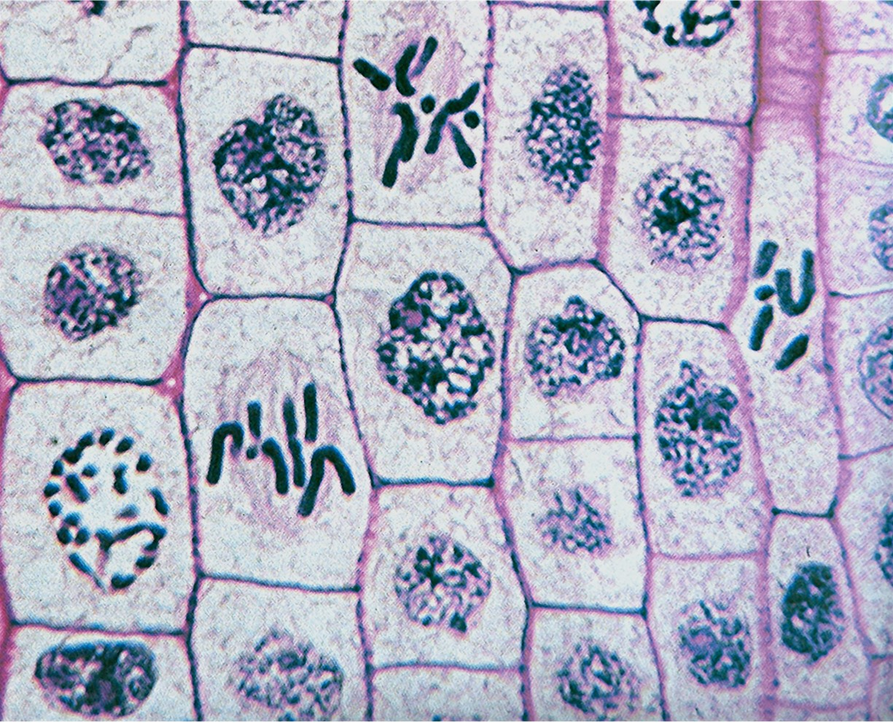
Locate the Four Mitotic Stages in Plants
Anaphase
Telophase
Metaphase
Prophase

Slide 52
Uncontrolled Mitosis
If mitosis is not controlled, unlimited cell division occurs causing cancerous tumors
Oncogenes are special proteins that increase the chance that a normal cell develops into a tumor cell
Cancer cells

