Slide 1
1. Hemophilia is a sex-linked, recessive trait. Which of the following describes the probability of hemophilia in the offspring of a man who does not have hemophilia and a woman whose father is a hemophiliac?
A. Each of their sons will have hemophilia.
B. None of their daughters will have hemophilia.
C. Their sons have a 50% chance of having hemophilia.
D. There is a 50% chance that their daughters will have hemophilia.

Slide 2
2. Alleles for the A and B blood cell antigens are codominant. The condition where no antigens are present on the blood cells (type O blood) is a recessive trait. Which set of parents can most likely produce a child with type O blood?
A. one parent with type AB blood, and the other parent with type A blood
B. one parent with type AB blood and the other parent with type O blood
C. one parent with heterozygous type A blood, and the other parent with type O blood
D. one parent with homozygous type A blood, and the other parent with homozygous type B blood

Slide 3
3. One of the parents of a child has phenylketonuria (PKU), which is caused by recessive alleles. The other parent does not have the PKU alleles. What is the chance that the couple will have a child with phenylketonuria?
A. 0%
B. 50%
C. 75%
D. 100%

Slide 4
4. Hitchhiker's thumb (H) is dominant to no hitchhiker's thumb (h). A woman who does not have hitchhiker's thumb marries a man who is heterozygous for hitchhiker's thumb. What is the probable genotypic ratio of their children?
A. 0% Hh: 100% hh
B. 50% Hh: 50% hh
C. 75% Hh: 25% hh
D. 100% Hh: 0% hh

Slide 5
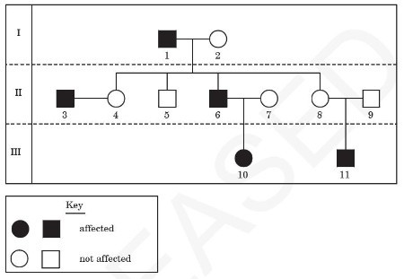
5. This diagram shows a pedigree for a recessive genetic disorder. What is the genotype of individual 6?
A. X^{H}X^{H}
B. X^{H}X^{h}
C. X^{H}Y
D. X^{h}Y

Slide 6
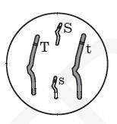
6. This diagram shows a diploid cell with two pairs of homologous chromosomes. Due to independent assortment, what is the possible genetic make-up of gametes produced by this organism?
A. SsTt
B. Ss, Tt
C. S, s, T, t
D. ST, St, sT, st

Slide 7
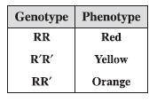
7. The table lists the trials for fruit color where allele R exhibits incomplete dominance over allele R'. Heterozygous fruit have orange phenotypes. What percent of offspring are expected to have an orange phenotype if the parent plants are orange (RR') and yellow (R'R')?
A. 25%
B. 50%
C. 75%
D. 100%

Slide 8
8. Mendel hypothesized that reproductive cells have only one factor for each inherited trait. This hypothesis is supported by which observation?
A. Haploid cells are produced by mitosis.
B. Diploid cells are produced by mitosis.
C. Haploid cells are produced by meiosis.
D. Diploid cells are produced by meiosis.

Slide 9
9. A human baby boy inherits a recessive allele from his mother. In which circumstance would he most likely show the trait coded for by the recessive allele?
A. The baby inherits the dominant allele from his father.
B. The allele is on an autosomal chromosome and the baby is a twin.
C. The allele is on the X chromosome.
D. The allele is on the Y chromosome.

Slide 10
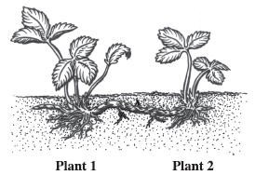
The diagram below shows two strawberry plants.
10. Plant 2 is produced asexually from Plant 1. If the leaf cells of Plant 1 have 56 chromosomes, how many chromosomes will be found in the leaf cells of Plant 2?
A. 14
B. 28
C. 56
D. 112

Slide 11
11. Which of the following best describes meiosis?
A. It is carried out in all tissues that require cell replacement.
B. It occurs only in cells in the reproductive structures of organisms.
C. It happens in all tissues except the brain and spinal cord.
D. It is the first stage of mitosis.

Slide 12
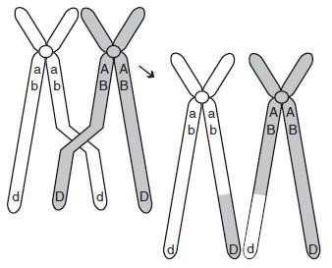
The diagram below shows homologous chromosomes during prophase I of meiosis.
12. Which of the following correctly describes the process being illustrated?
A. mutation in which the DNA content of the gene is altered
B. segregation of sister chromatids
C. condensation and segregation of alleles
D. crossing-over in which alleles are exchanged

Slide 13
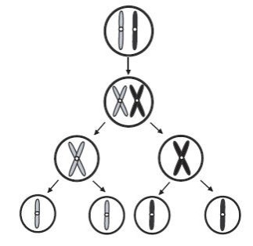
13. The diagram below shows a cellular process that occurs in organisms. What is the name of this process?
A. meiosis
B. mitosis
C. endocytosis
D. phagocytosis

Slide 14
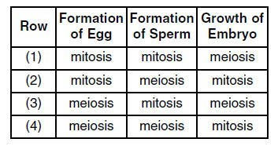
14. Which row in the chart below indicates the correct process for each event indicated?
A. row 1
B. row 2
C. row 3
D. row 4

Slide 15
15. A scientist wants to change the DNA of a sexually reproducing organism and have the new DNA present in every cell of the organism. In order to do this after fertilization, she would change the DNA in which of the following?
A. zygote
B. placenta
C. testes of the father
D. ovaries of the mother

