Slide 1
Water: What you need to know!
SC.912.L.18.12 Properties of Water

Slide 2
Need to Know:
You need to know the specific properties of water that contribute to Earth's suitability as an environment for life. These include:
cohesive behavior
adhesive behavior – more in plants
ability to moderate temperature
expansion upon freezing
versatility as a solvent
hydrogen bonding and polarity

Slide 3
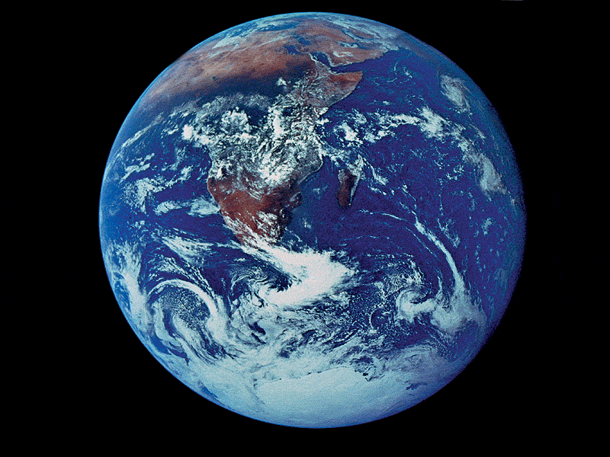
Water is the solvent of life

Slide 4
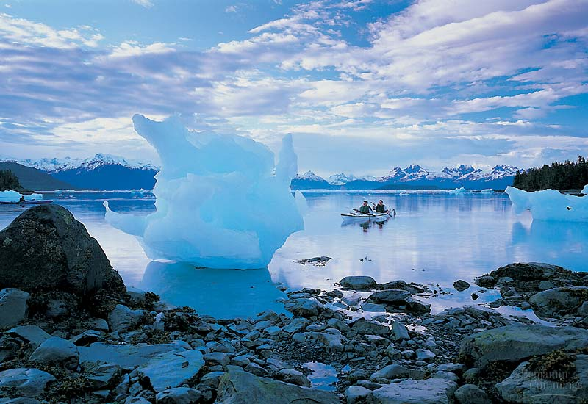
Like no other common substance, water exists in nature in all three physical states:
as a solid
as a liquid
as a gas

Slide 5
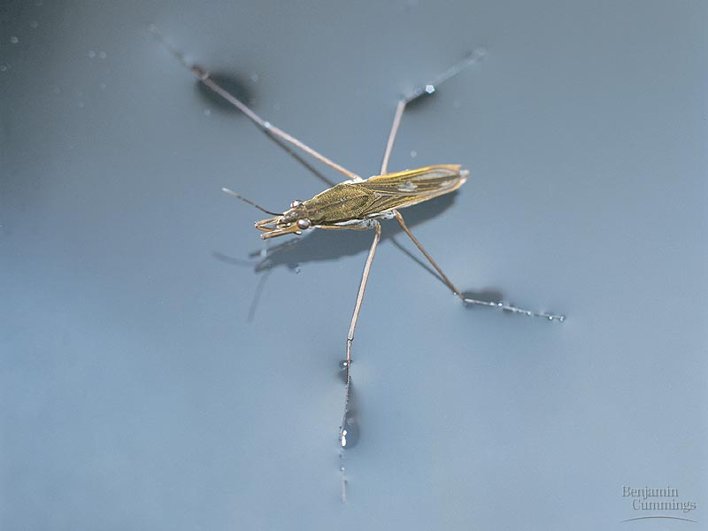
Cohesion:
Water molecules stick together
surface tension

Slide 6
Adhesion: water molecules can move great distances

Slide 7
Temperature
Water’s hydrogen bonds moderate temperature
Water can absorb a great deal of heat energy without a large increase in temperature because It takes a lot of energy to disrupt hydrogen bonds
Heat = amount of energy associated with molecular movement
Temperature = measure of the intensity of heat: measures a substance’s molecular motion

Slide 8
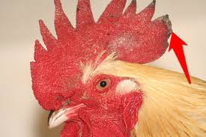
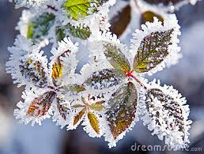
Temperature regulation:
Homeostasis –
Living things need to maintain “normal” internal temperatures for the cellular chemical reactions to take place.
Not good for living things to freeze or boil!

Slide 9
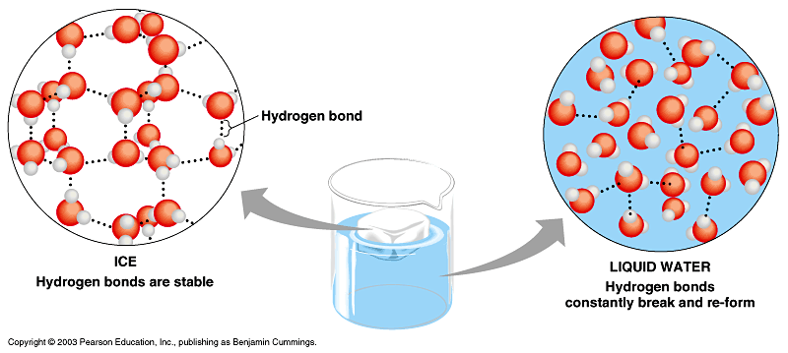
Ice floats!
Water molecules in ice (solid water) are farther apart than the molecules in liquid water

Slide 10
Ice is therefore less dense than liquid water, causing it to float..
Why is this a good thing?
If ice sank, it wouldn’t thaw
Creates a blanket of insulation

Slide 11
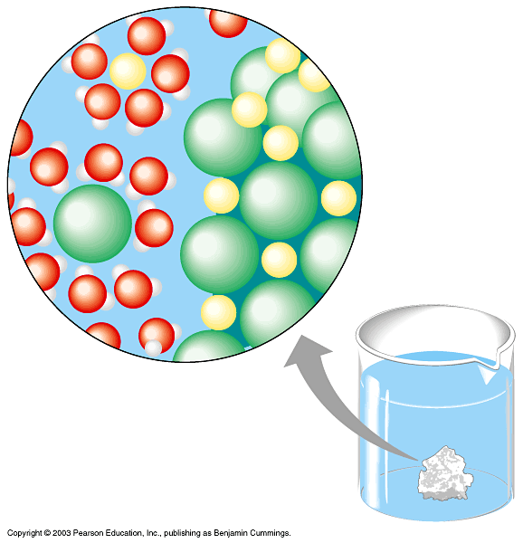
Water is the universal solvent
Solution - a homogenous mixture of two or more substances : aqueous solutions
Solvent - dissolving agent (water)
Solute - substance dissolved
Polar or charged solutes
can “stick” to water
molecules
(i.e. Dissolve)

Slide 12
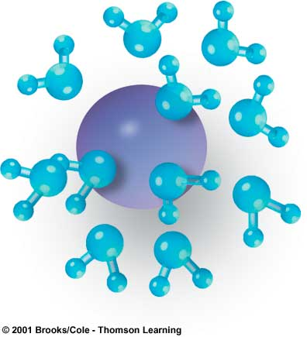
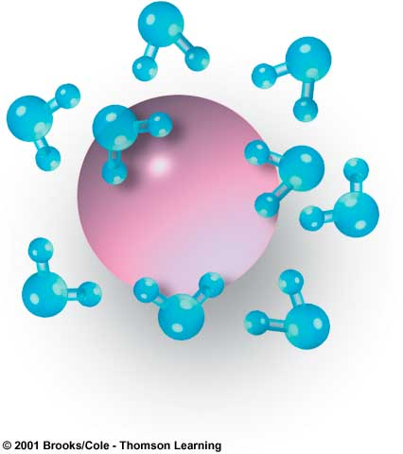
–
–
+
+
+
–
+
+
–
+
Na⁺
–
+
+
+
+
–
–
Cl–
+
–
+
–
+
–
+
+
+
+
–
+

Slide 13
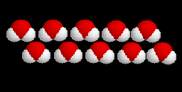
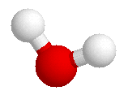
Water
A water molecule (H₂O), is made up of three atoms --- one oxygen and two hydrogen.
H
H
O
H
Notes:
1

Slide 14
Water is Polar
In each water molecule, the oxygen atom attracts more than its "fair share" of electrons
The oxygen end “acts” negative
The hydrogen end “acts” positive
Causes the water to be POLAR
However, Water is neutral (equal number of e- and p+) --- Zero Net Charge

Slide 15
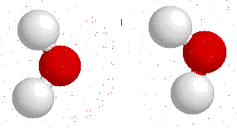
Interaction Between Water Molecules
Negative Oxygen end of one water molecule is attracted to the Positive Hydrogen end of another water molecule to form a HYDROGEN BOND

Slide 16
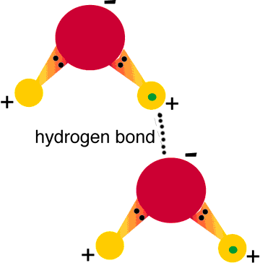
Hydrogen Bonds Exist Between Water Molecules
Formed between a highly Electronegative atom of a polar molecule and a Hydrogen
One hydrogen bond is weak, but many hydrogen bonds are strong

Slide 17
Water is so special it has its own name for diffusion….
OSMOSIS

Slide 18
Sample Questions:
Water is essential for life. Its special properties make water the single most important molecule in plant life. Which of the following properties of water enables it to move from the roots to the leaves of plants?
A. Water expands as it freezes.
B. Water is an excellent solvent.
C. Water exhibits cohesive behavior.
D. Water is able to moderate temperature.

Slide 19
Large bodies of water, such as lakes and oceans, do not quickly fluctuate in temperature. What is the reason for this phenomenon?
A. Water is an acid.
B. Water is a versatile solvent.
C. Water has a high heat capacity.
D. Water acts as a buffer.

Slide 20
Why does ice stay at the top of oceans instead of sinking to the bottom?
A. Ice is colder than liquid water.
B. Ice is less dense than liquid water.
C. Ice is more dense than liquid water.
D. Ice is warmer than liquid water.

Slide 21
Water is often called the "universal solvent" because many substances can be dissolved in water. What property of water allows it to be such a versatile solvent?
A. purity
B. polarity and cohesion
C. high heat capacity
D. expansion upon freezing

