Slide 1
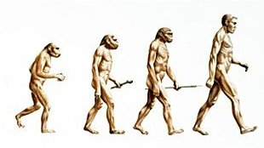
Chapter 16
Evolution and Natural Selection

Slide 2
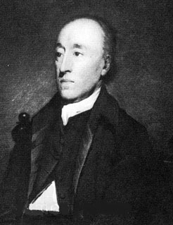
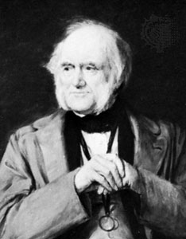
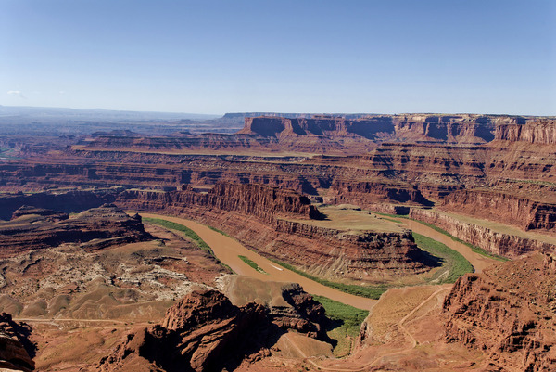
Geological Change
James Hutton proposed that geological processes like mountain formation and erosion take much longer than originally hypothesized (1785)
Concept of deep time
Charles Lyell reasoned that presently observable geological processes must be responsible for the Earth’s landscape (1830)
Erosion, earthquakes, etc.

Slide 3
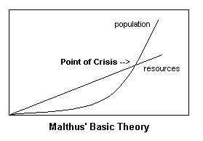
Population Dynamics
Thomas Malthus reasoned that limited resources could not support the growing population (1798)
Darwin applied this concept to other organisms
Trees produce thousands of seeds- not all can survive
Which individuals will survive?
The ones with some advantage over the others

Slide 4
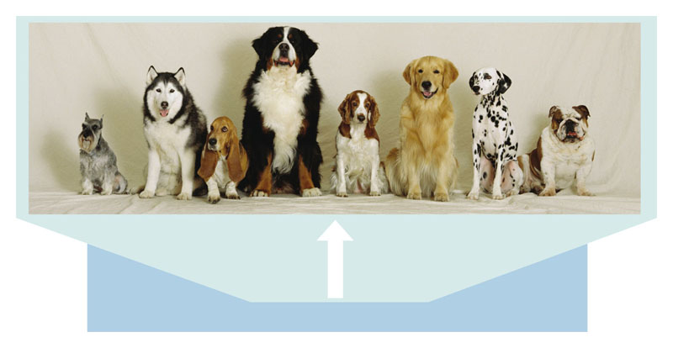
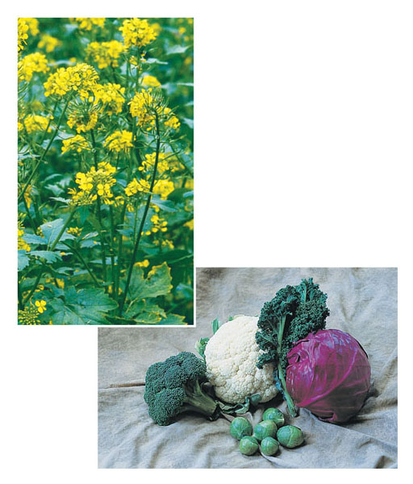
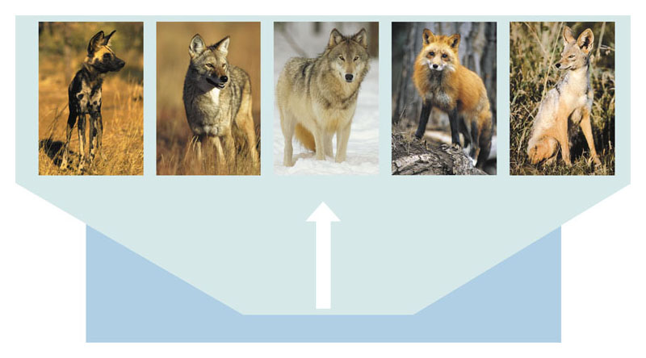
Darwin knew about artificial selection and argued that a similar process must occur in nature.
Wild mustard
& domestic
vegetables
Domestic dogs
Wild canids

Slide 5
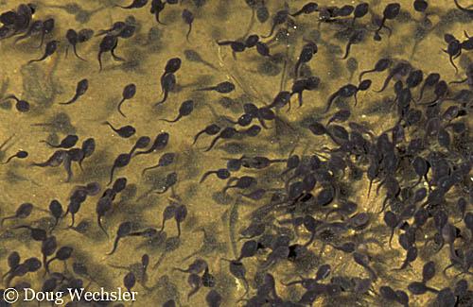
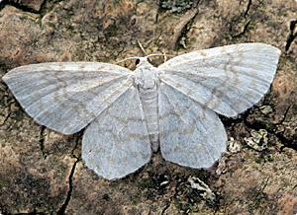
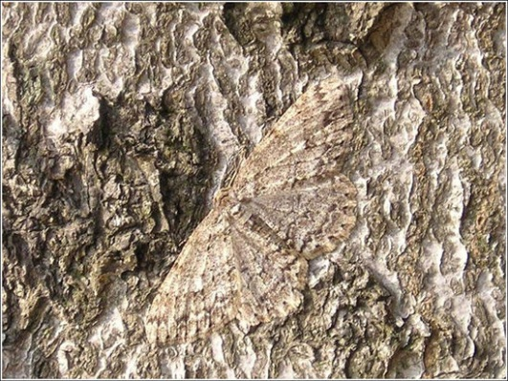
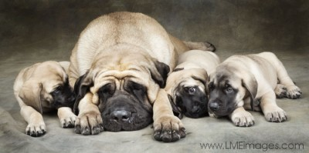
Natural Selection
Based on 3 facts:
Organisms produce more offspring than can survive
Individuals vary in their characteristics
Many characteristics are passed from parents to their offspring

Slide 6
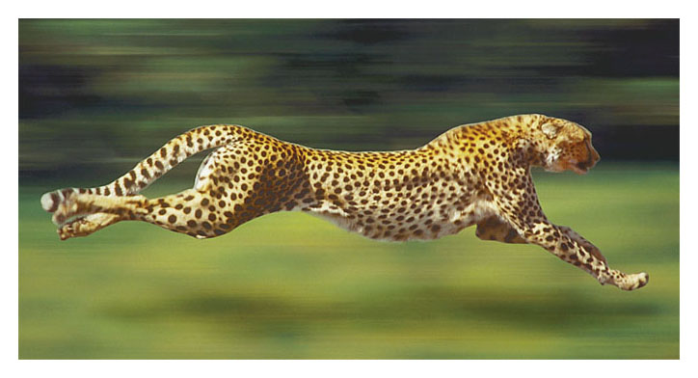
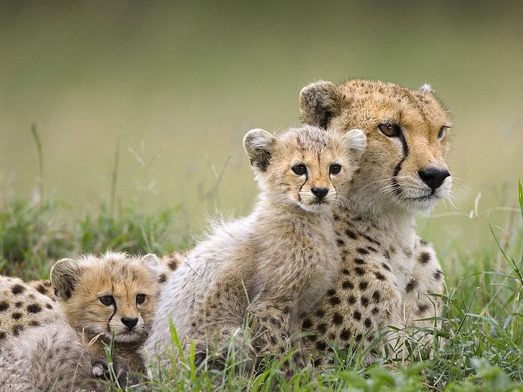
Natural Selection
It logically follows that…
Some individuals will be better suited to their environment
They will survive and reproduce more successfully than others without those characteristics

Slide 7
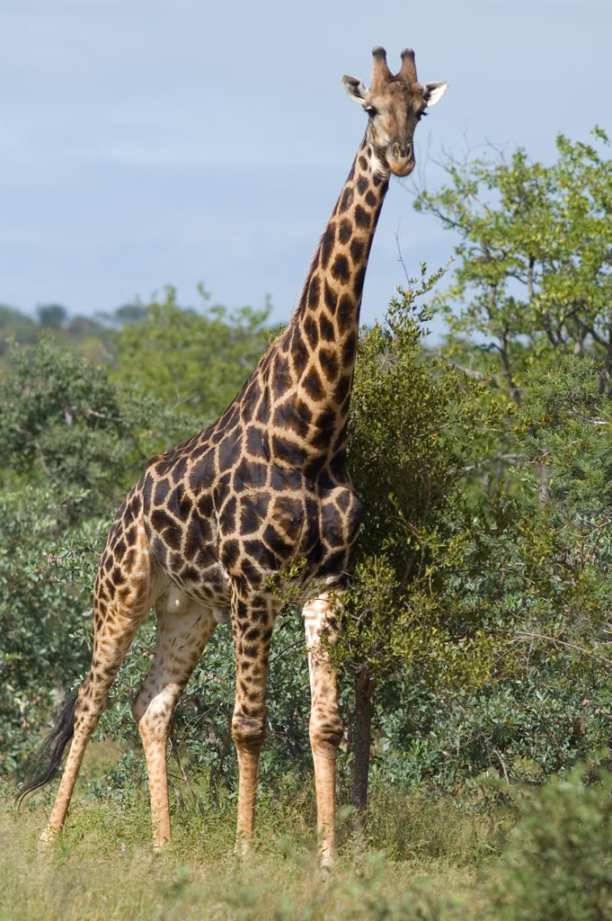
Natural Selection
Future generations will therefore contain more genes from better suited individuals
As a result, more individuals will resemble those better suited ancestors
Some characteristics will be exaggerated while others are minimized or even lost

Slide 8
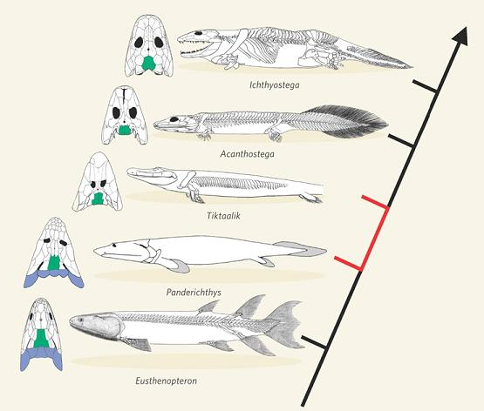
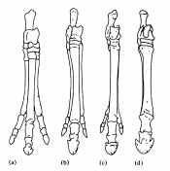
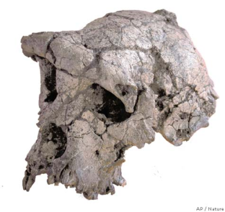
Evidence for Evolution: Fossils and Age of the Earth
Earth is 4.5 billion years old
Enough time for natural selection to account for all of life’s variety
Although incomplete, fossils show evidence for change
Intermediates between species
Common ancestors

Slide 9
Evidence for Evolution: Fossils and Age of the Earth
Earth is 4.5 billion years old
Enough time for natural selection to account for all of life’s variety
Although incomplete, fossils show evidence for change
Intermediates between species
Common ancestors

Slide 10
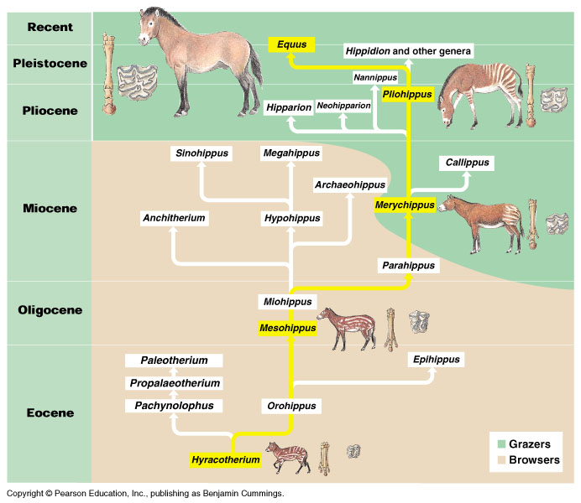
Evidence for Evolution: Fossils and Age of the Earth
Earth is 4.5 billion years old
Enough time for natural selection to account for all of life’s variety
Although incomplete, fossils show evidence for change
Intermediates between species
Common ancestors

Slide 11
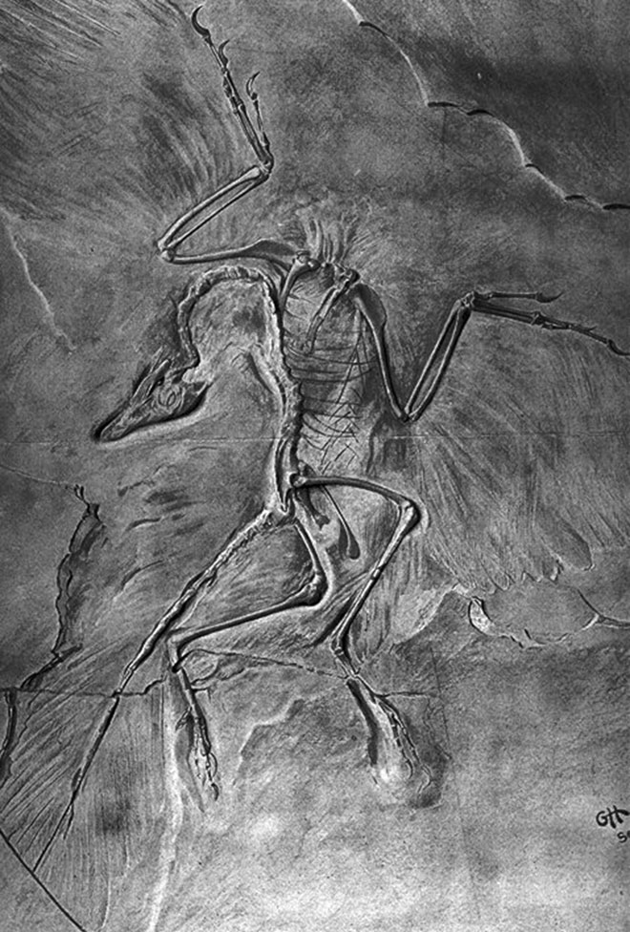
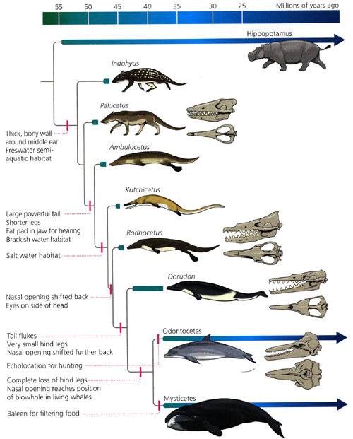

Slide 12
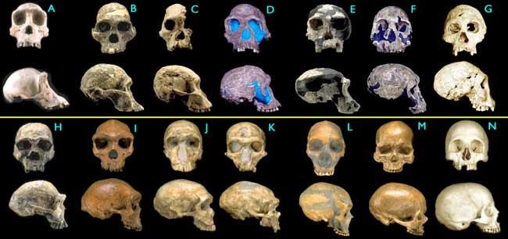

Slide 13
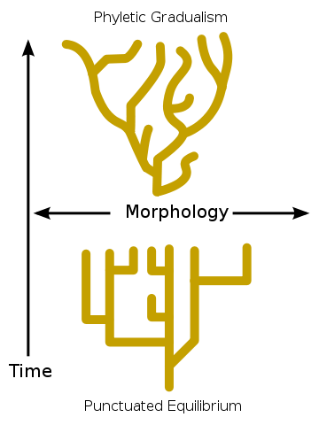
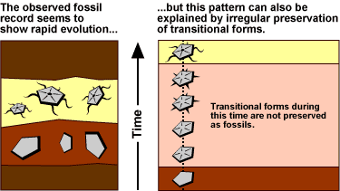
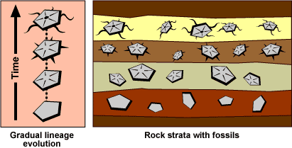
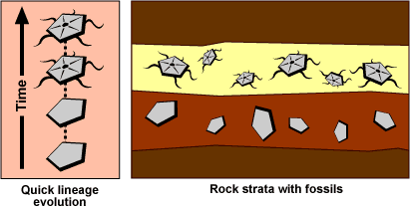
Evidence for Evolution: Fossils and Age of the Earth
Fossils are found in layers called strata
Deeper = older
Gradualism- slow, steady change
Punctuated equilibrium- long periods of stability interrupted by quick change

Slide 14
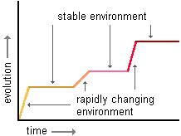
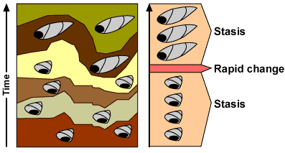
Evidence for Evolution: Gradualism vs. Punctuated Equilibrium

Slide 15
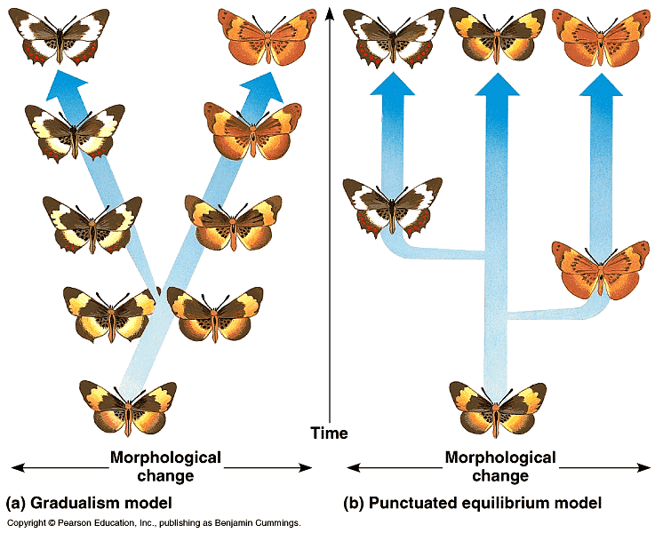
Evidence for Evolution: Fossils and Age of the Earth

Slide 16
Evidence for Evolution: Fossils and Age of the Earth
Earth is 4.5 billion years old
Enough time for natural selection to account for all of life’s variety
Although incomplete, fossils show evidence for change
Intermediates between species
Common ancestors

Slide 17
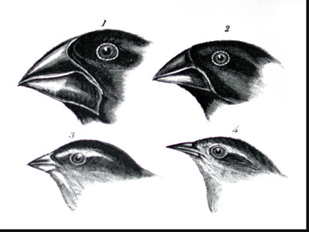
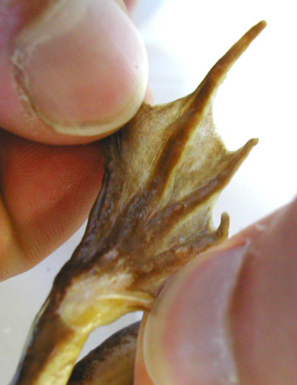
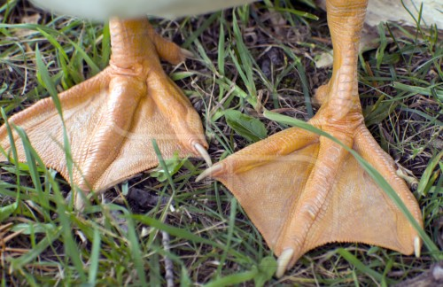
Evidence for Evolution: Biogeography
Closely related species have slight differences in different environments
Ex: Galapagos finches
Distantly related species can evolve similar adaptations
Result of similar environmental pressures
Convergent Evolution
Analogous Structures
Ex: webbed feet, wings

Slide 18
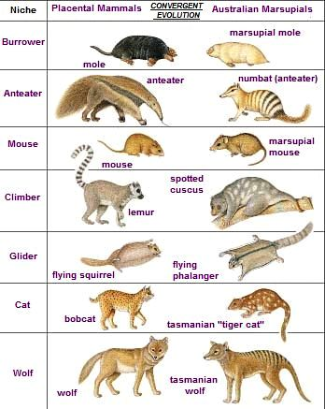
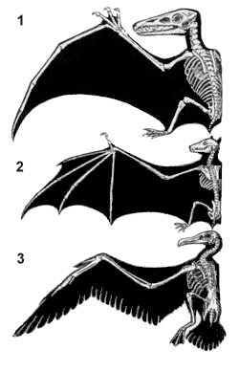

Slide 19
Which is correct?

Slide 20
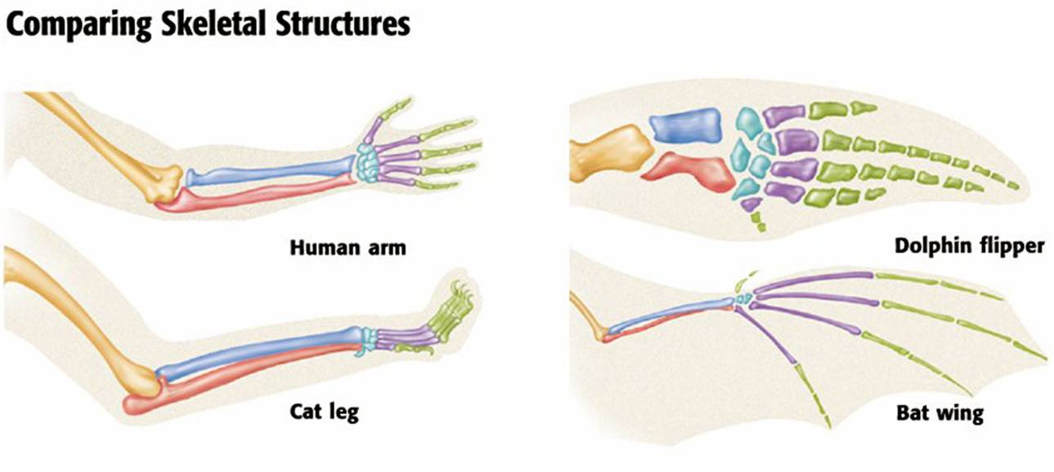
Evidence for Evolution: Homologous Structures
Same basic form
With modifications
Inherited from a common ancestor

Slide 21
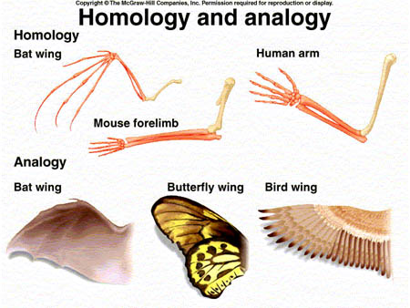

Slide 22
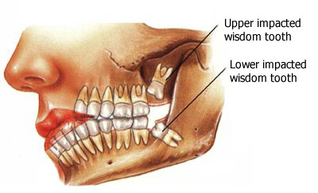
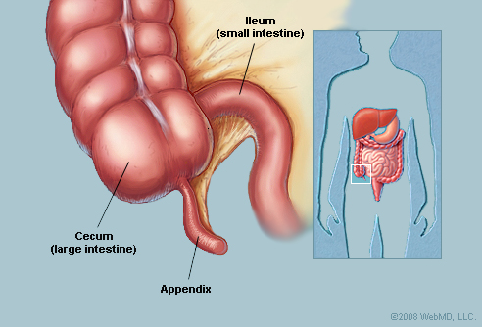
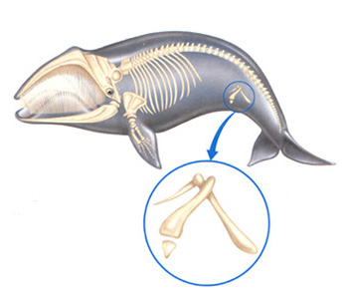
Evidence for Evolution: Vestigial Structures
Remnants of once useful structures and organs
Have lost much or all of their function
Typically reduced and eventually eliminated

Slide 23
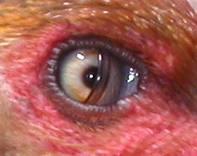
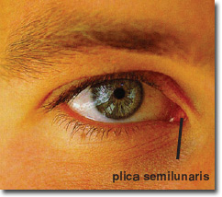
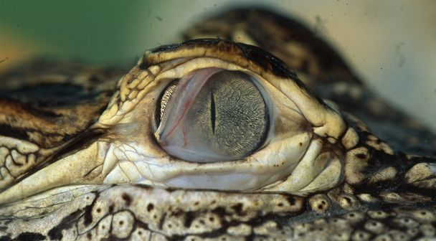
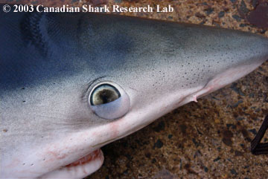
Vestigial Structures: Nictitating Membrane

Slide 24
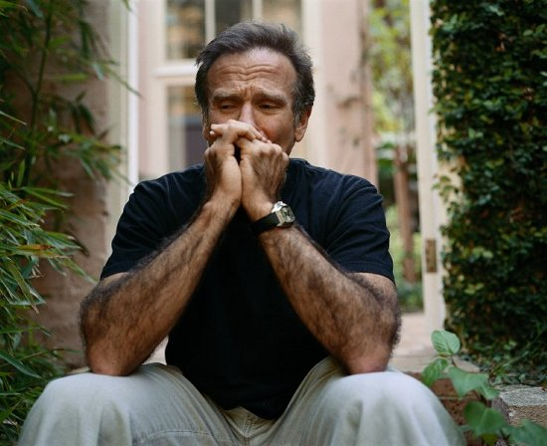
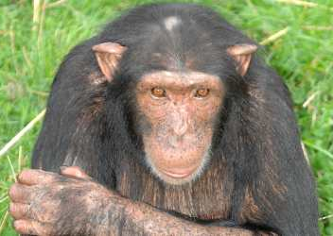
Vestigial Structures: Body Hair

Slide 25
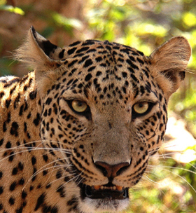
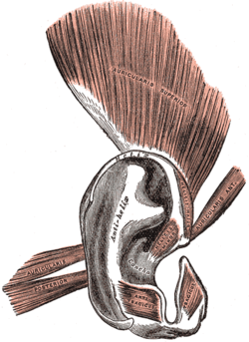
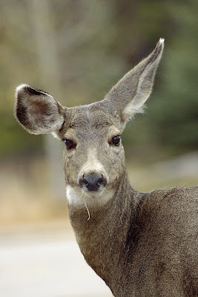
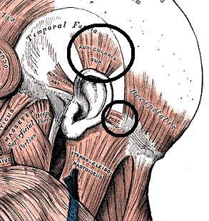
Vestigial Structures: Ear Muscles

Slide 26
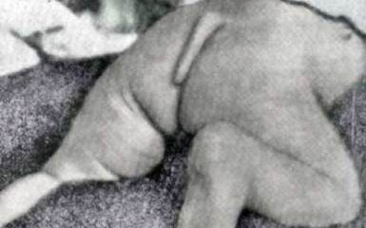
Vestigial Structures: Tailbone (Coccyx)

Slide 27
Evidence for Evolution: Embryology
Similarities in the patterns of embryological development
Evidence for common descent

Slide 28
Evidence for Evolution: Genetics and Molecular Biology
Universal genetic code (DNA)
Same biochemical processes
Ex: transcription, translation, cell division, etc.
More closely related organisms have more similar DNA
Common genes and proteins

